Slide 1
Module 2
Regression: linear regression, logistic regression
Error functions in regression, MSE, L1, L2
Cross entropy multivariate regression.
Classification: Naive Bayes classifier, Support Vector machines, Decision trees -random forests,
Ensemble methods: boosting, bagging.

Slide 2
Linear Regression
Linear regression is a type of supervised machine-learning algorithm that learns from the labelled datasets and maps the data points with most optimized linear functions which can be used for prediction on new datasets.
It assumes that there is a linear relationship between the input and output, meaning the output changes at a constant rate as the input changes. This relationship is represented by a straight line.
Models relationship between dependent variable (Y) and independent variable(s) (X)
Goal: minimize the error between observed and predicted values
Foundation for understanding advanced machine learning models

Slide 3
Linear Regression
For example, we want to predict a student's exam score based on how many hours they studied.
We observe that as students study more hours, their scores go up.
In the example of predicting exam scores based on hours studied.
Independent variable (input): Hours studied because it's the factor we control or observe.
Dependent variable (output): Exam score because it depends on how many hours were studied.
We use the independent variable to predict the dependent variable.

Slide 4
Best Fit Line in Linear Regression
In linear regression, the best-fit line is the straight line that most accurately represents the relationship between the independent variable (input) and the dependent variable (output).
It is the line that minimizes the difference between the actual data points and the predicted values from the model.
Goal of the Best-Fit Line
The goal of linear regression is to find a straight line that minimizes the error (the difference) between the observed data points and the predicted values. This line helps us predict the dependent variable for new, unseen data.

Slide 5
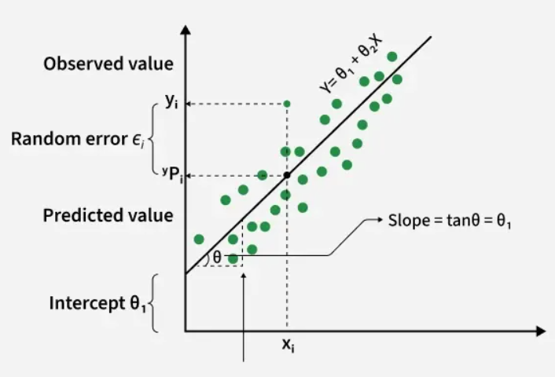
Best Fit Line in Linear Regression

Slide 6
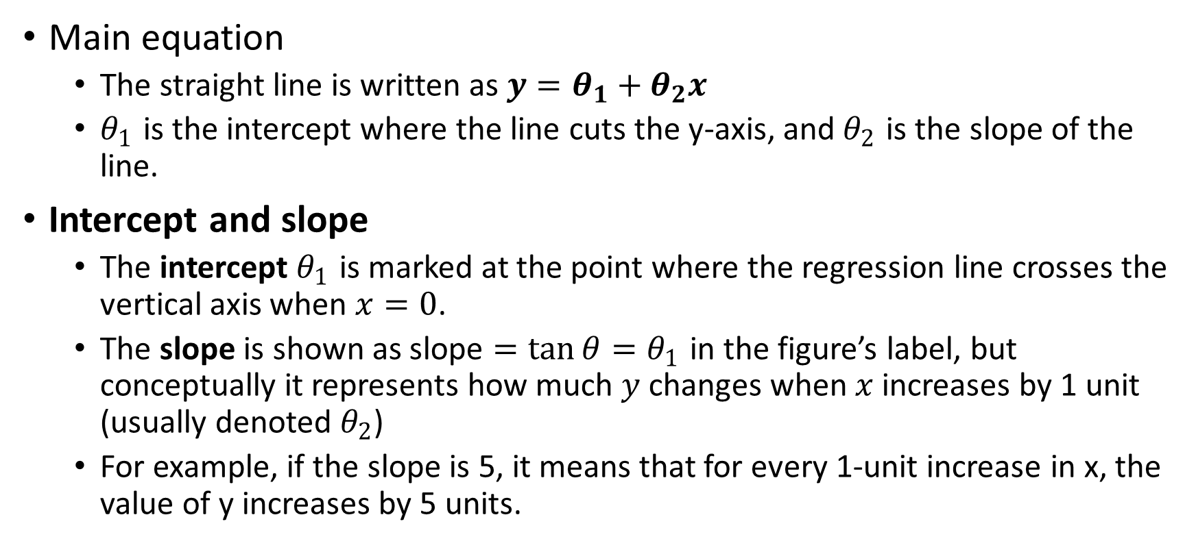
Best Fit Line in Linear Regression
Main equation
The straight line is written as $y=θ_{1}+θ_{2}x$
$θ_{1}$ is the intercept where the line cuts the y‑axis, and $θ_{2}$ is the slope of the line.
Intercept and slope
The intercept $θ_{1}$ is marked at the point where the regression line crosses the vertical axis when $x=0$.
The slope is shown as $\text{slope}=\tan{θ}=θ_{1}$ in the figure’s label, but conceptually it represents how much $y$ changes when $x$ increases by 1 unit (usually denoted $θ_{2}$)
For example, if the slope is 5, it means that for every 1-unit increase in x, the value of y increases by 5 units.

Slide 7
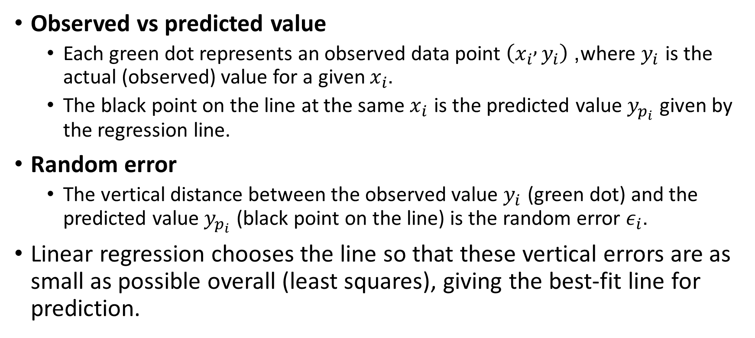
Best Fit Line in Linear Regression
Observed vs predicted value
Each green dot represents an observed data point $\left(x_{i} , y_{i}\right)$, where $y_{i}$ is the actual (observed) value for a given $x_{i}$.
The black point on the line at the same $x_{i}$ is the predicted value $y_{p_{i}}$ given by the regression line.
Random error
The vertical distance between the observed value $y_{i}$ (green dot) and the predicted value $y_{p_{i}}$ (black point on the line) is the random error $ε_{i}$.
Linear regression chooses the line so that these vertical errors are as small as possible overall (least squares), giving the best‑fit line for prediction.

Slide 8
Best Fit Line in Linear Regression
Y is called a dependent or target variable
X is called an independent variable also known as the predictor of Y.
There are many types of functions or modules that can be used for regression.
A linear function is the simplest type of function. Here, X may be a single feature or multiple features representing the problem.

Slide 9
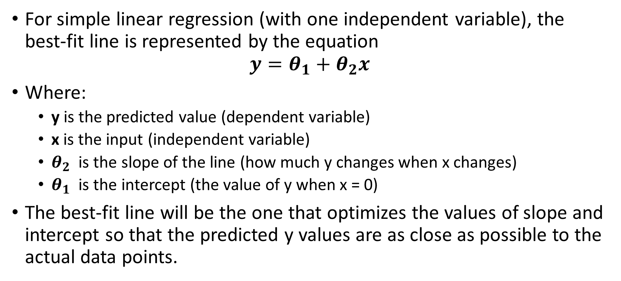
Equation of the Best-Fit Line
For simple linear regression (with one independent variable), the best-fit line is represented by the equation
$$y=θ_{1}+θ_{2}x$$
Where:
y is the predicted value (dependent variable)
x is the input (independent variable)
$θ_{2}$ is the slope of the line (how much y changes when x changes)
$θ_{1}$ is the intercept (the value of y when x = 0)
The best-fit line will be the one that optimizes the values of slope and intercept so that the predicted y values are as close as possible to the actual data points.

Slide 10
Assumptions of the Linear Regression
Linearity: The relationship between inputs (X) and the output (Y) is a straight line.
Independence of Errors: The errors in predictions should not affect each other.
Constant Variance (Homoscedasticity): The errors should have equal spread across all values of the input. If the spread changes (like fans out or shrinks), it's called heteroscedasticity and it's a problem for the model.
Normality of Errors: The errors should follow a normal (bell-shaped) distribution.
No Multicollinearity(for multiple regression): Input variables shouldn’t be too closely related to each other.
No Autocorrelation: Errors shouldn't show repeating patterns, especially in time-based data.
Additivity: The total effect on Y is just the sum of effects from each X, no mixing or interaction between them.

Slide 11
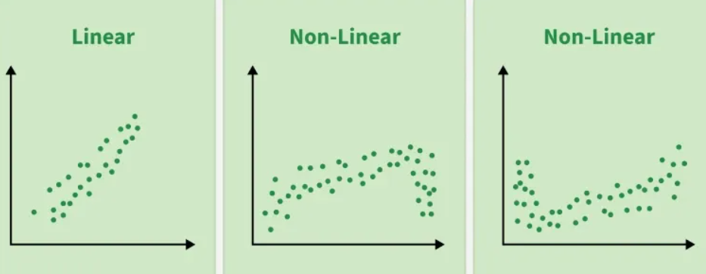
Assumptions of the Linear Regression

Slide 12
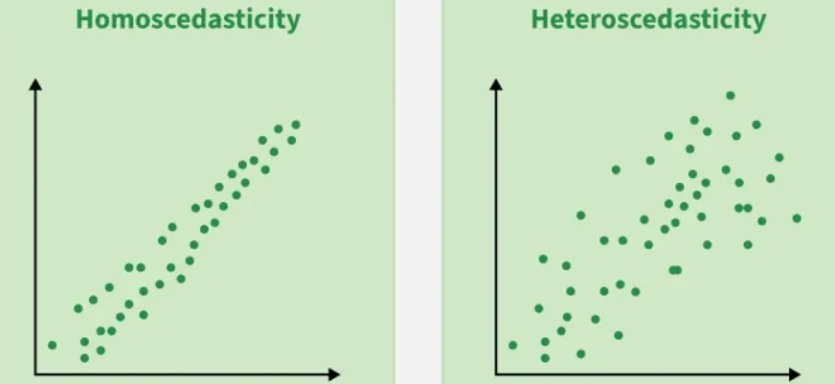
Assumptions of the Linear Regression

Slide 13
Types of Linear Regression
Simple Linear Regression
One independent variable (X) predicting one dependent variable (Y)
Multiple Linear Regression
Multiple independent variables predicting one dependent variable

Slide 14
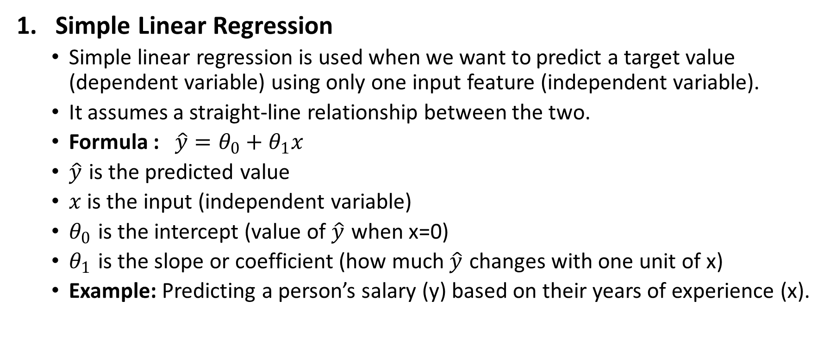
Type of Linear Regression
Simple Linear Regression
Simple linear regression is used when we want to predict a target value (dependent variable) using only one input feature (independent variable).
It assumes a straight-line relationship between the two.
Formula : $\hat{y}=θ_{0}+θ_{1}x$
$\hat{y}$​ is the predicted value
$x$ is the input (independent variable)
$θ_{0}$ is the intercept (value of $\hat{y}\text{​}$ when x=0)
$θ_{1}$​ is the slope or coefficient (how much $\hat{y}$​ changes with one unit of x)
Example: Predicting a person’s salary (y) based on their years of experience (x).

Slide 15
Type of Linear Regression
2. Multiple Linear Regression
Multiple linear regression involves more than one independent variable and one dependent variable.
A linear model makes a prediction by simply computing a weighted sum of the input features, plus a constant called the bias term (also called the intercept term)
Example : Real Estate: Predict property prices using location, size and other factors.

Slide 16
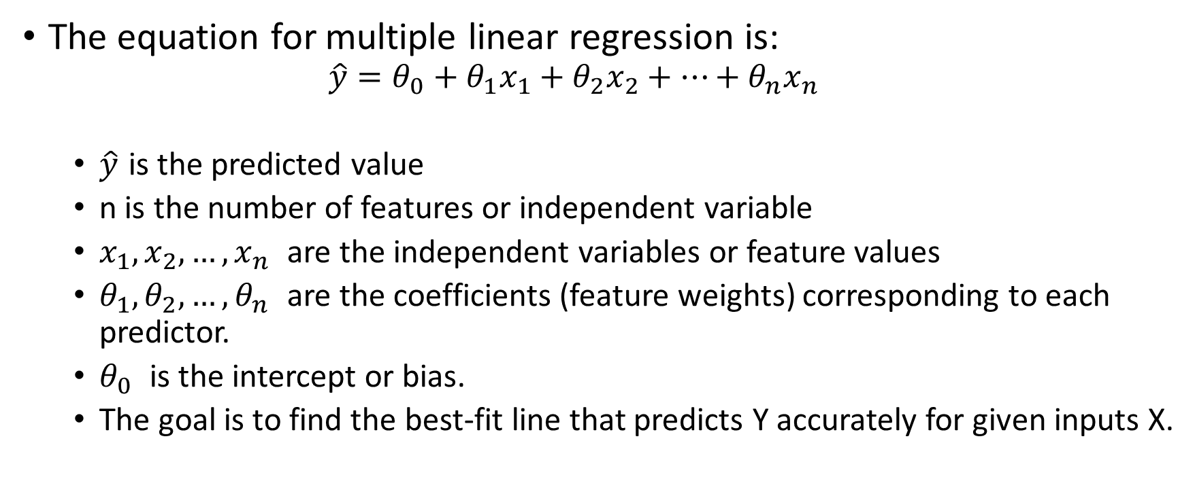
Multiple Linear Regression
The equation for multiple linear regression is:
$$\hat{y}=θ_{0}+θ_{1}x_{1}+θ_{2}x_{2}+⋯+θ_{n}x_{n}$$
$\hat{y}$​ is the predicted value
n is the number of features or independent variable
$x_{1},x_{2},…,x_{n}$ are the independent variables or feature values
$θ_{1},θ_{2},…,θ_{n}$ are the coefficients (feature weights) corresponding to each predictor.
$θ_{0}$ is the intercept or bias.
The goal is to find the best-fit line that predicts Y accurately for given inputs X.

Slide 17
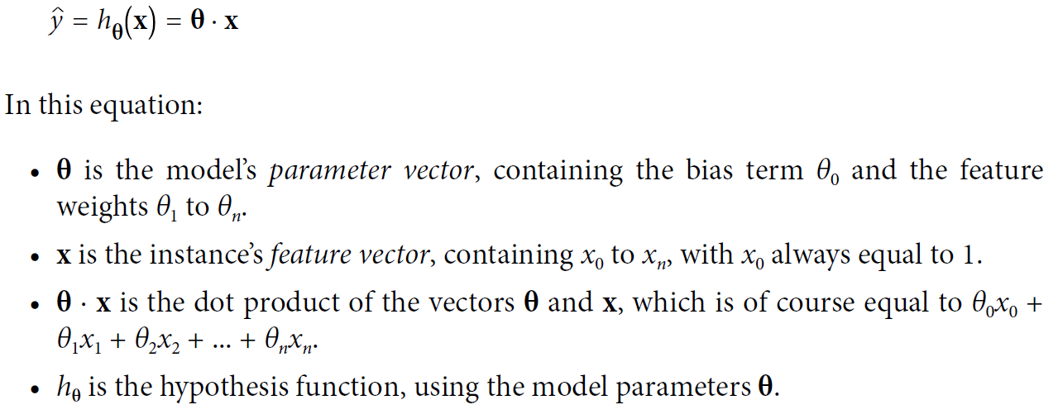
Linear Regression model prediction (vectorized form)

Slide 18

Linear Regression model prediction (vectorized form)
In Machine Learning, vectors are often represented as column vectors, which are 2D arrays with a single column.
If θ and x are column vectors, then the prediction is y = θ⊺x, where θ⊺ is the transpose of θ (a row vector instead of a column vector) and θ⊺x is the matrix multiplication of θ⊺ and x.
MSE cost function for a Linear Regression model

Slide 19
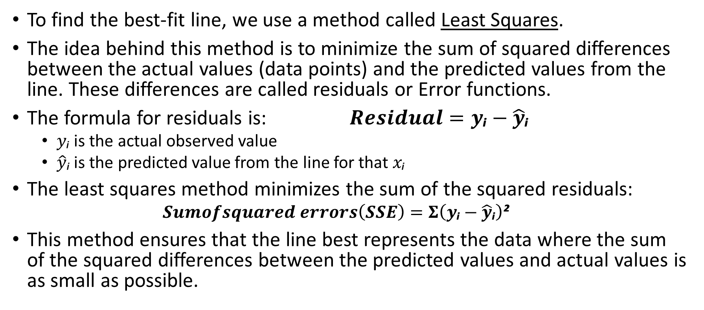
Minimizing the Error: The Least Squares Method
To find the best-fit line, we use a method called Least Squares.
The idea behind this method is to minimize the sum of squared differences between the actual values (data points) and the predicted values from the line. These differences are called residuals or Error functions.
The formula for residuals is: $Residual=y\text{ᵢ}−\hat{y}\text{ᵢ}$
$y\text{ᵢ}$ is the actual observed value
$\hat{y}\text{ᵢ}$ is the predicted value from the line for that $x\text{ᵢ}$
The least squares method minimizes the sum of the squared residuals:
$$Sumofsquared errors\left(SSE\right)=Σ\left(y\text{ᵢ}−\hat{y}\text{ᵢ}\right)\text{²}$$
This method ensures that the line best represents the data where the sum of the squared differences between the predicted values and actual values is as small as possible.

Slide 20
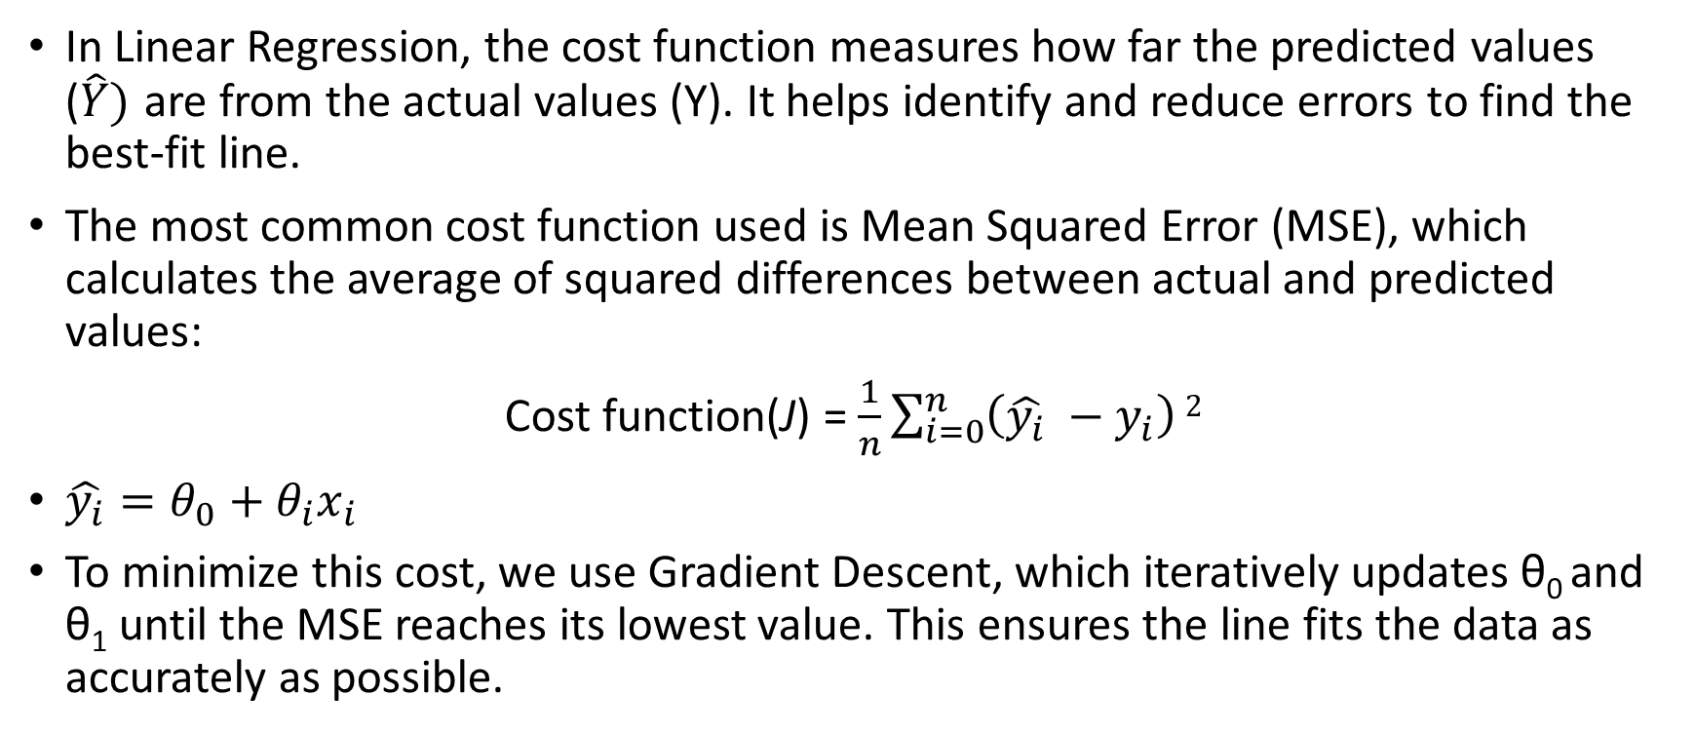
Cost function for Linear Regression
In Linear Regression, the cost function measures how far the predicted values ($\hat{Y})$ are from the actual values (Y). It helps identify and reduce errors to find the best-fit line.
The most common cost function used is Mean Squared Error (MSE), which calculates the average of squared differences between actual and predicted values:
Cost function(J) = $\frac{1}{n}\sum_{i=0}^{n}{\left(\hat{y_{i}} −y_{i}\right)}2$
$\hat{y_{i}}=θ_{0}+θ_{i}x_{i}$
To minimize this cost, we use Gradient Descent, which iteratively updates θ₀ and θ₁ until the MSE reaches its lowest value. This ensures the line fits the data as accurately as possible.

Slide 21
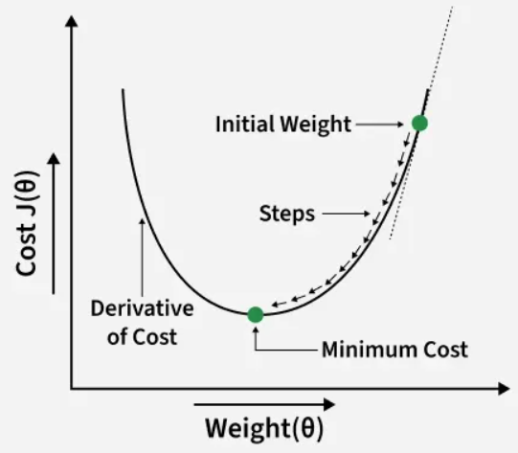
Gradient Descent for Linear Regression
Gradient descent is an optimization technique used to train a linear regression model by minimizing the prediction error.
It works by starting with random model parameters and repeatedly adjusting them to reduce the difference between predicted and actual values.

Slide 22
Gradient Descent for Linear Regression
How it works:
Start with random values for slope and intercept.
Calculate the error between predicted and actual values.
Find how much each parameter contributes to the error (gradient).
Update the parameters in the direction that reduces the error.
Repeat until the error is as small as possible.
This helps the model find the best-fit line for the data.

Slide 23
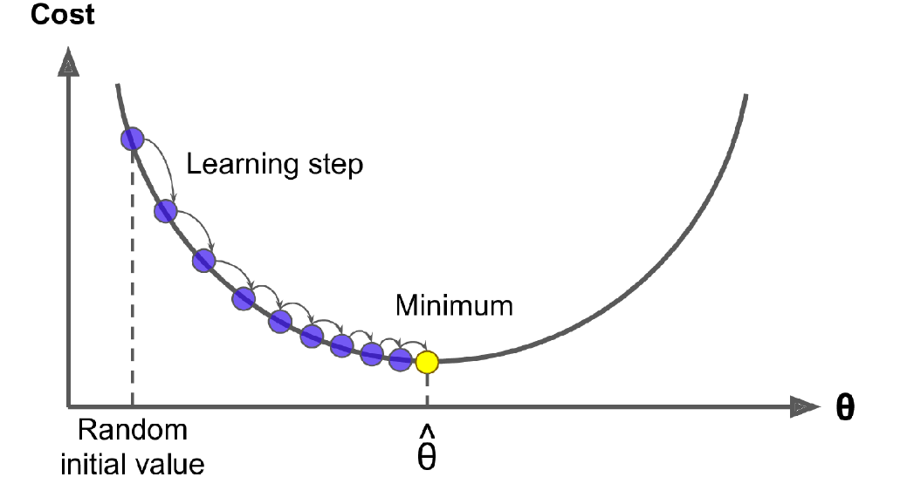
Gradient Descent for Linear Regression
In this depiction of Gradient Descent, the model parameters are initialized randomly and get tweaked repeatedly to minimize the cost function; the learning step size is proportional to the slope of the cost function, so the steps gradually get smaller as the parameters approach the minimum

Slide 24
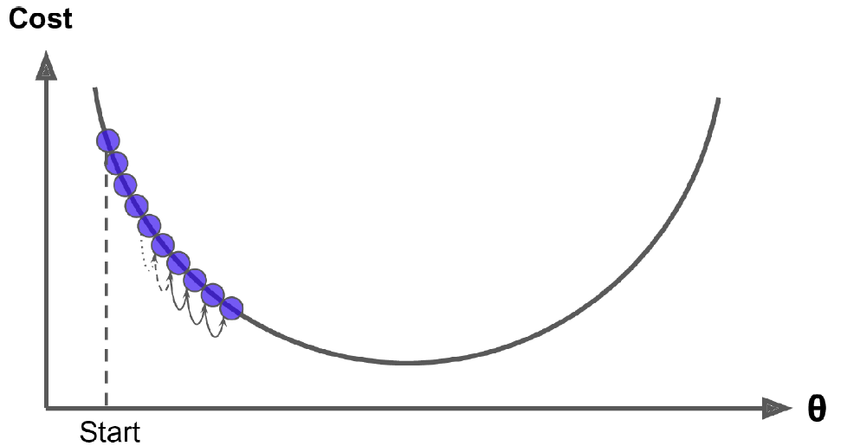
Gradient Descent for Linear Regression
An important parameter in Gradient Descent is the size of the steps, determined by the learning rate hyperparameter.
If the learning rate is too small, then the algorithm will have to go through many iterations to converge, which will take a long time

Slide 25
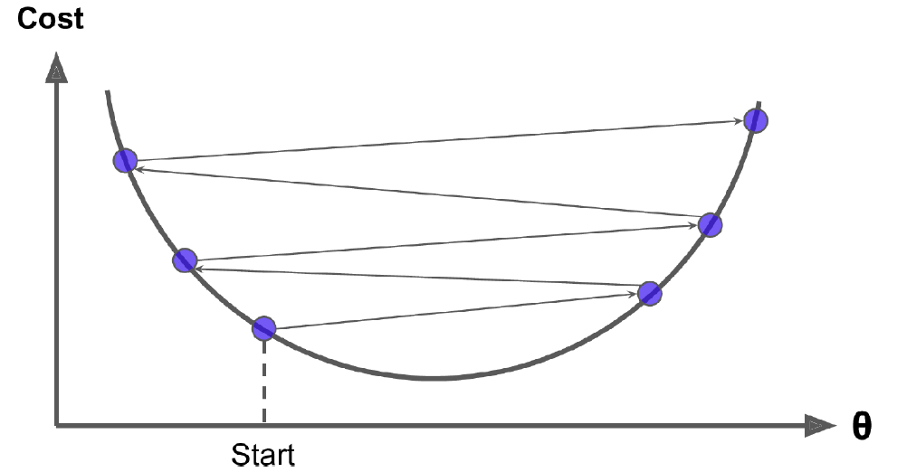
Gradient Descent for Linear Regression
If the learning rate is too high, you might jump across the valley and end up on the other side, possibly even higher up than you were before. This might make the algorithm diverge, with larger and larger values, failing to find a good solution

Slide 26
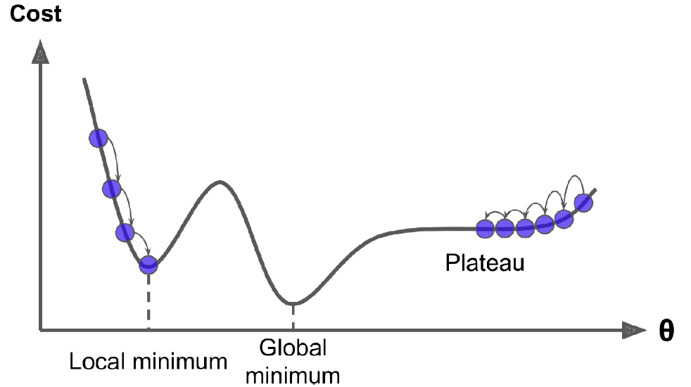
Two main challenges with Gradient Descent
If the random initialization starts the algorithm on the left, then it will converge to a local minimum, which is not as good as the global minimum.
If it starts on the right, then it will take a very long time to cross the plateau. And if you stop too early, you will never reach the global minimum.

Slide 27
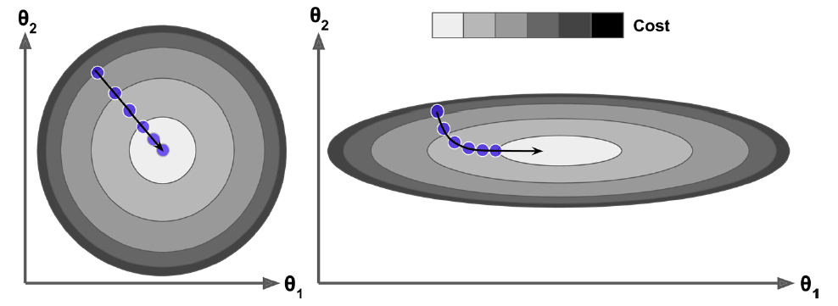
Gradient Descent with (left) and without (right) feature scaling
Gradient Descent on a training set where features 1 and 2 have the same scale (on the left), and on a training set where feature 1 has much smaller values than feature 2 (on the right).
On the left the Gradient Descent algorithm goes straight toward the minimum, thereby reaching it quickly, whereas on the right it first goes in a direction almost orthogonal to the direction of the global minimum, and it ends with a long march down an almost flat valley. It will eventually reach the minimum, but it will take a long time.

Slide 28
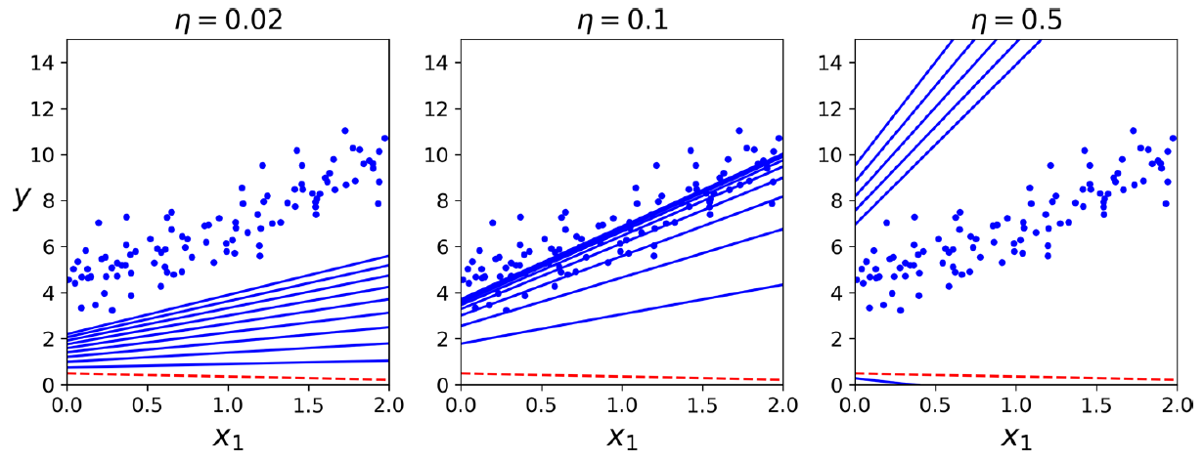
Gradient Descent with various learning rates
On the left, the learning rate is too low: the algorithm will eventually reach the solution, but it will take a long time. In the middle, the learning rate looks pretty good: in just a few iterations, it has already converged to the solution. On the right, the learning rate is too high: the algorithm diverges, jumping all over the place and actually getting further and further away from the solution at every step.

Slide 29
Type of Gradient Descent
Batch Gradient Descent
Stochastic Gradient Descent
Mini-batch Gradient Descent

Slide 30

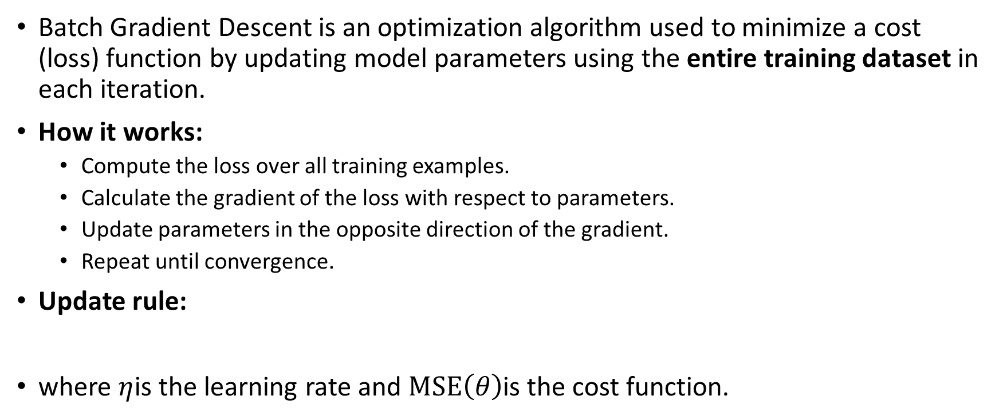
Batch Gradient Descent
Batch Gradient Descent is an optimization algorithm used to minimize a cost (loss) function by updating model parameters using the entire training dataset in each iteration.
How it works:
Compute the loss over all training examples.
Calculate the gradient of the loss with respect to parameters.
Update parameters in the opposite direction of the gradient.
Repeat until convergence.
Update rule:
where $η$is the learning rate and $MSE\left(θ\right)$is the cost function.

Slide 31
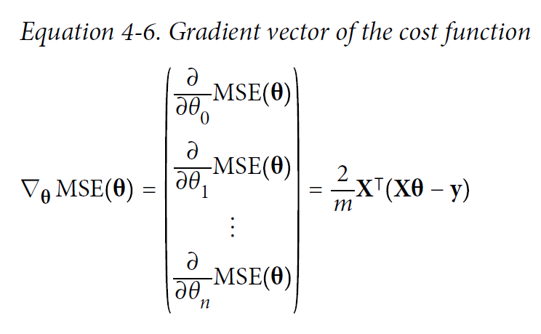
Batch Gradient Descent

Slide 32
Batch Gradient Descent
Advantages:
Stable and smooth convergence.
Deterministic updates (same result for same data and learning rate).
Suitable for small to medium-sized datasets.
Disadvantages:
Computationally expensive for large datasets.
High memory usage.
Slow convergence per iteration compared to stochastic methods.

Slide 33

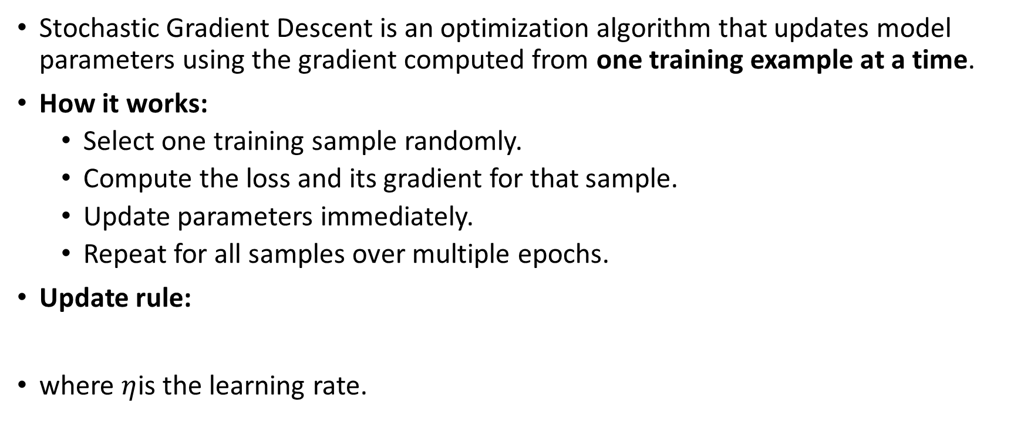
Stochastic Gradient Descent
Stochastic Gradient Descent is an optimization algorithm that updates model parameters using the gradient computed from one training example at a time.
How it works:
Select one training sample randomly.
Compute the loss and its gradient for that sample.
Update parameters immediately.
Repeat for all samples over multiple epochs.
Update rule:
where $η$is the learning rate.

Slide 34
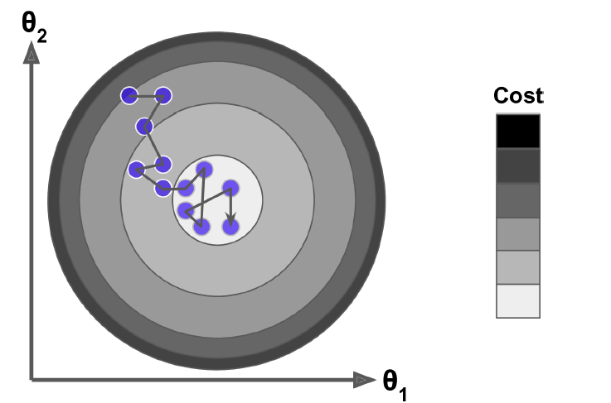
Stochastic Gradient Descent
This algorithm is much less regular than Batch Gradient Descent: instead of gently decreasing until it reaches the minimum, the cost function will bounce up and down, decreasing only on average.
Over time it will end up very close to the minimum, but once it gets there it will continue to bounce around, never settling down. So once the algorithm stops, the final parameter values are good, but not optimal.

Slide 35
Stochastic Gradient Descent
Advantages:
Faster updates and quicker initial convergence.
Efficient for large and online datasets.
Can escape local minima due to noisy updates.
Disadvantages:
High variance in updates → noisy convergence.
Loss function fluctuates instead of decreasing smoothly.
Sensitive to learning rate choice.

Slide 36
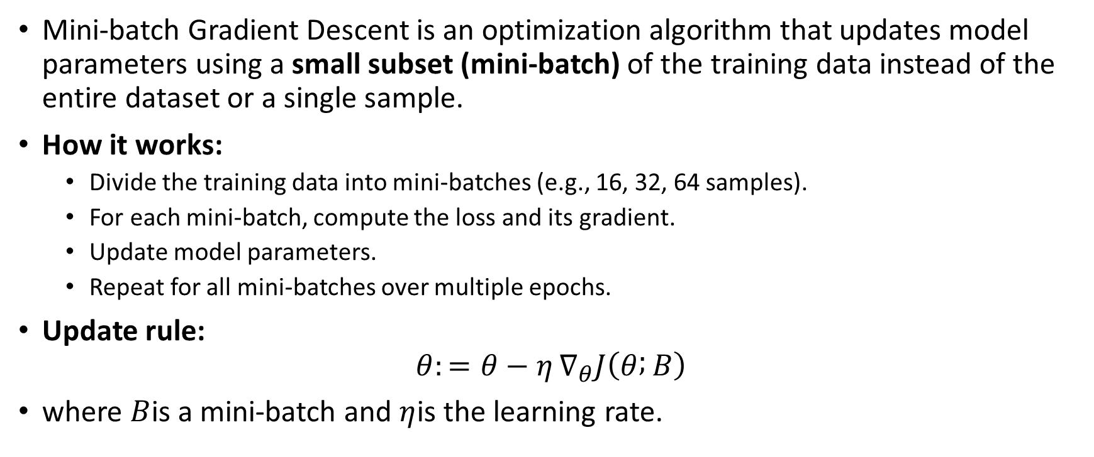
Mini-batch Gradient Descent
Mini-batch Gradient Descent is an optimization algorithm that updates model parameters using a small subset (mini-batch) of the training data instead of the entire dataset or a single sample.
How it works:
Divide the training data into mini-batches (e.g., 16, 32, 64 samples).
For each mini-batch, compute the loss and its gradient.
Update model parameters.
Repeat for all mini-batches over multiple epochs.
Update rule:
$$θ:=θ−η ∇_{θ}J\left(θ ; B\right)$$
where $B$is a mini-batch and $η$is the learning rate.

Slide 37
Mini-batch Gradient Descent
Advantages:
Faster and more efficient than Batch Gradient Descent.
Less noisy than Stochastic Gradient Descent.
Enables parallel computation on GPUs/TPUs.
Provides a good trade-off between speed and stability.
Disadvantages:
Requires tuning of mini-batch size.
Still shows some noise in convergence.
Performance depends on hardware and batch selection.

Slide 38
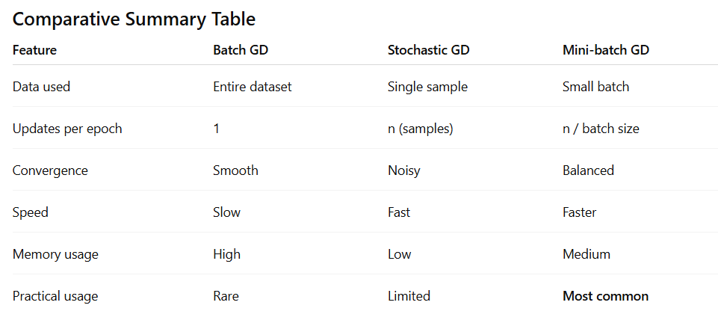

Slide 39
Evaluation Metrics for Linear Regression
A variety of evaluation measures can be used to determine the strength of any linear regression model. These assessment metrics often give an indication of how well the model is producing the observed outputs.
The most common measurements are:
Mean Square Error (MSE)
Mean Absolute Error (MAE)
Root Mean Squared Error (RMSE)

Slide 40
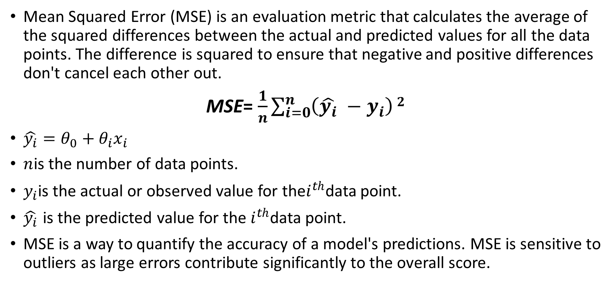
1. Mean Square Error (MSE)
Mean Squared Error (MSE) is an evaluation metric that calculates the average of the squared differences between the actual and predicted values for all the data points. The difference is squared to ensure that negative and positive differences don't cancel each other out.
MSE= $\frac{1}{n}\sum_{i=0}^{n}{\left(\hat{y_{i}} −y_{i}\right)}2$
$\hat{y_{i}}=θ_{0}+θ_{i}x_{i}$
$n$is the number of data points.
$y_{i}$is the actual or observed value for the$i^{th}$data point.
$\hat{y_{i}}$ is the predicted value for the $i^{th}$data point.
MSE is a way to quantify the accuracy of a model's predictions. MSE is sensitive to outliers as large errors contribute significantly to the overall score.

Slide 41
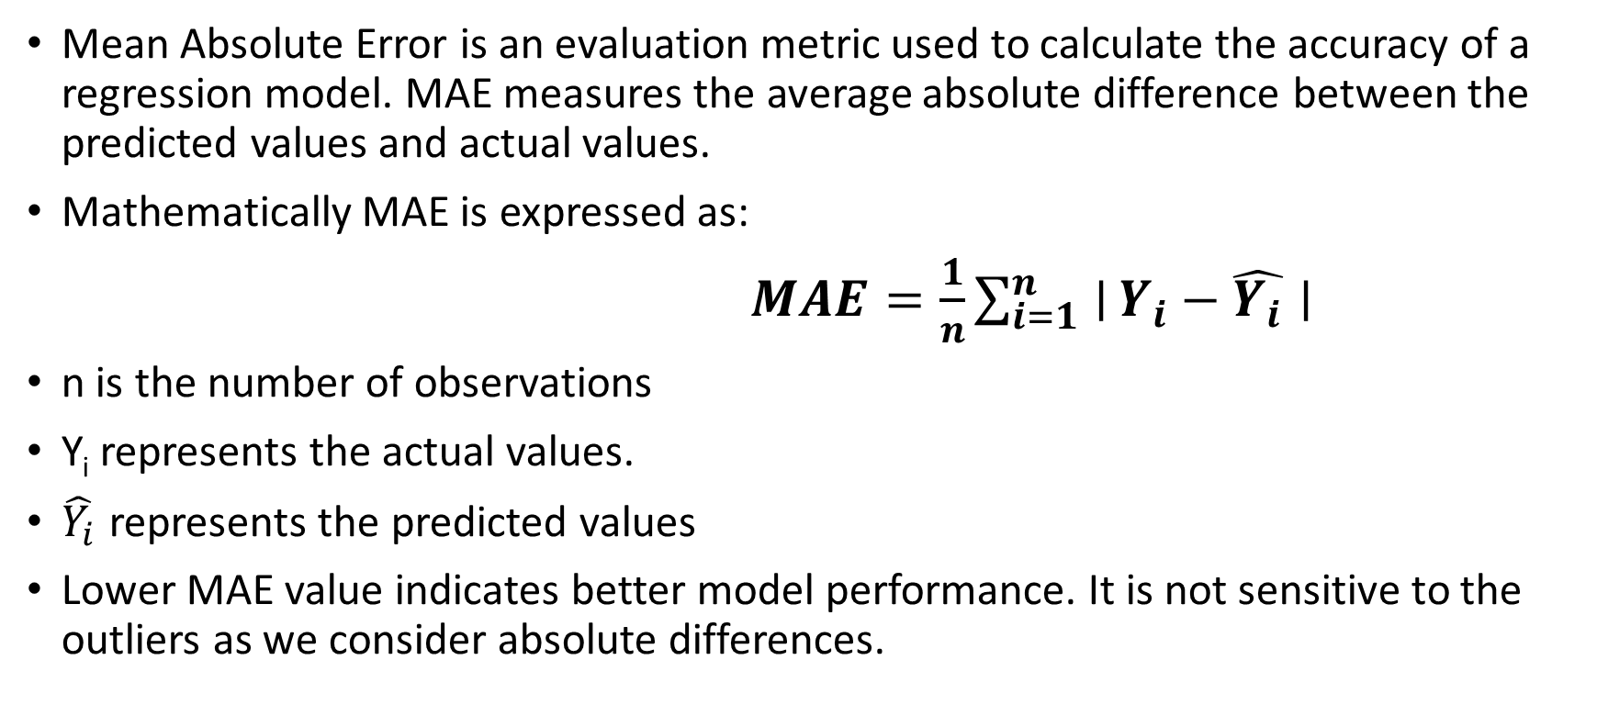
2. Mean Absolute Error (MAE)
Mean Absolute Error is an evaluation metric used to calculate the accuracy of a regression model. MAE measures the average absolute difference between the predicted values and actual values.
Mathematically MAE is expressed as:
$MAE=\frac{1}{n}\sum_{i=1}^{n}{∣}Y_{i}−\hat{Y_{i}}∣$
n is the number of observations
Y_{i} represents the actual values.
$\hat{Y_{i}}$ represents the predicted values
Lower MAE value indicates better model performance. It is not sensitive to the outliers as we consider absolute differences.

Slide 42
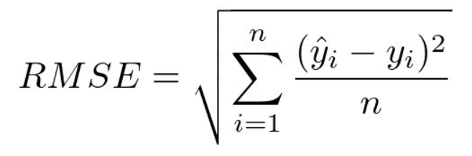
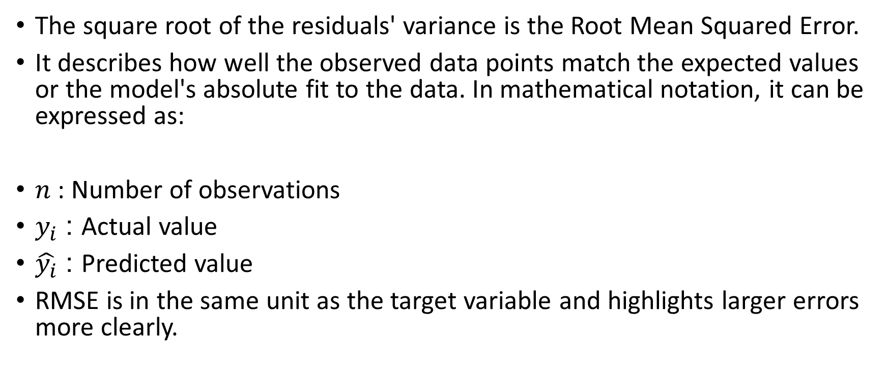
3.Root Mean Squared Error (RMSE)
The square root of the residuals' variance is the Root Mean Squared Error.
It describes how well the observed data points match the expected values or the model's absolute fit to the data. In mathematical notation, it can be expressed as:
$n$ : Number of observations
$y_{i}$ : Actual value
$\hat{y_{i}}$​ : Predicted value
RMSE is in the same unit as the target variable and highlights larger errors more clearly.

Slide 43
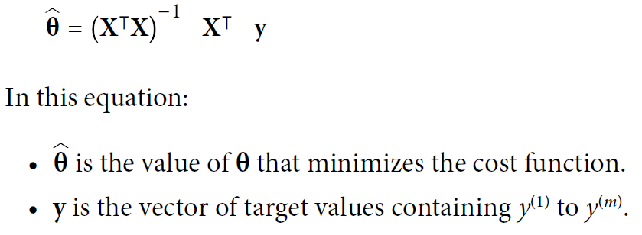
Normal Equation

Slide 44
Regularization Techniques for Linear Models
Regularization is a technique used to prevent overfitting by adding a penalty term to the loss (cost) function.
It discourages the model from learning overly complex patterns and helps it generalize better to unseen data.
Lasso Regression (L1 Regularization)
Ridge Regression (L2 Regularization)
Elastic Net Regression

Slide 45

1. Lasso Regression (L1 Regularization)
Least Absolute Shrinkage and Selection Operator Regression
Lasso Regression is a technique used for regularizing a linear regression model, it adds a penalty term to the linear regression objective function to prevent overfitting.
Lasso Regression cost function
First term is the least squares loss, representing the squared difference between predicted and actual values.
Second term is the L1 regularization term, it penalizes the sum of absolute values of the regression coefficient θ_{i}.

Slide 46

2. Ridge Regression (L2 Regularization) Tikhonov regularization
Ridge regression is a linear regression technique that adds a regularization
term to the standard linear objective.
Goal is to prevent overfitting by penalizing large coefficient in linear regression equation. It useful when the dataset has multicollinearity where predictor variables are highly correlated.
This forces the learning algorithm to not only fit the data but also keep the model weights as small as possible. Note that the regularization term should only be added to the cost function during training.
Once the model is trained, you want to use the unregularized performance measure to evaluate the model’s performance.

Slide 47

2. Ridge Regression (L2 Regularization) Tikhonov regularization
Ridge Regression cost function
First term is the least squares loss, representing the squared difference between predicted and actual values.
Second term is the L2 regularization term, it penalizes the sum of square of values of the regression coefficient θ_{j}.
Bias term θ₀ is not regularized (the sum starts at i = 1, not 0). If we define w as the vector of feature weights (θ₁ to θ_{n} ), then the regularization term is equal to .(∥ w ∥₂)², where ∥ w ∥₂ represents the ℓ2 norm of the weight vector.

Slide 48

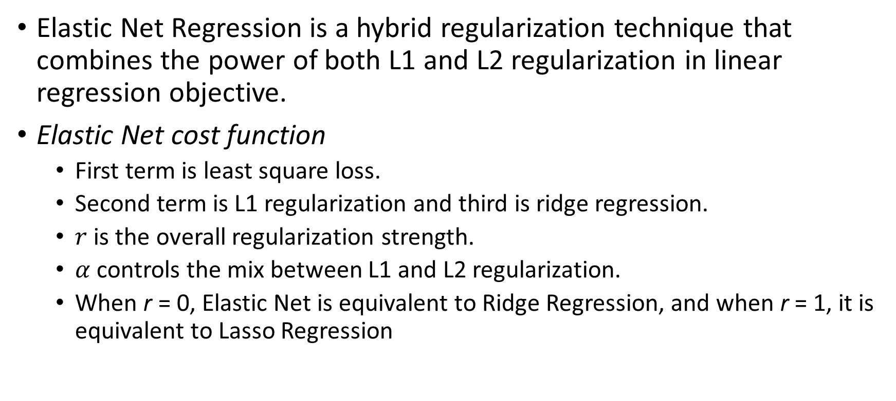
3. Elastic Net Regression
Elastic Net Regression is a hybrid regularization technique that combines the power of both L1 and L2 regularization in linear regression objective.
Elastic Net cost function
First term is least square loss.
Second term is L1 regularization and third is ridge regression.
$r$ is the overall regularization strength.
$α$controls the mix between L1 and L2 regularization.
When r = 0, Elastic Net is equivalent to Ridge Regression, and when r = 1, it is equivalent to Lasso Regression

Slide 49
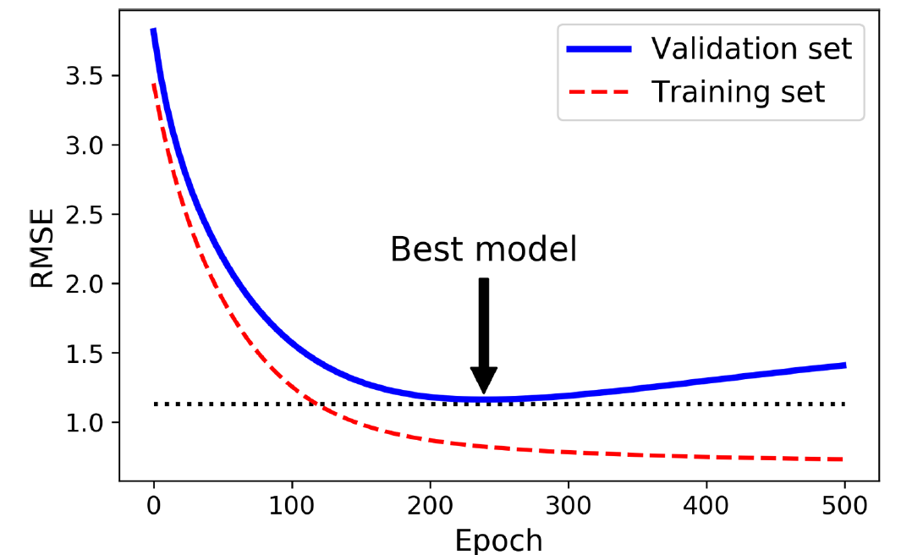
Early Stopping
A very different way to regularize iterative learning algorithms such as Gradient Descent is to stop training as soon as the validation error reaches a minimum. This is called early stopping.
With early stopping, stop training as soon as the validation error(RMSE) reaches the minimum(validation error stops decreasing and starts to go back up) .

Slide 50
Why Linear Regression is Important
Here’s why linear regression is important:
Simplicity and Interpretability: It’s easy to understand and interpret, making it a starting point for learning about machine learning.
Predictive Ability: Helps predict future outcomes based on past data, making it useful in various fields like finance, healthcare and marketing.
Basis for Other Models: Many advanced algorithms, like logistic regression or neural networks, build on the concepts of linear regression.
Efficiency: It’s computationally efficient and works well for problems with a linear relationship.
Widely Used: It’s one of the most widely used techniques in both statistics and machine learning for regression tasks.
Analysis: It provides insights into relationships between variables (e.g., how much one variable influences another).

Slide 51
Advantages of Linear Regression
Linear regression is a relatively simple algorithm, making it easy to understand and implement. The coefficients of the linear regression model can be interpreted as the change in the dependent variable for a one-unit change in the independent variable, providing insights into the relationships between variables.
Linear regression is computationally efficient and can handle large datasets effectively. It can be trained quickly on large datasets, making it suitable for real-time applications.
Linear regression is relatively robust to outliers compared to other machine learning algorithms. Outliers may have a smaller impact on the overall model performance.
Linear regression often serves as a good baseline model for comparison with more complex machine learning algorithms.
Linear regression is a well-established algorithm with a rich history and is widely available in various machine learning libraries and software packages.

Slide 52
Limitations of Linear Regression
Linear regression assumes a linear relationship between the dependent and independent variables. If the relationship is not linear, the model may not perform well.
Linear regression is sensitive to multicollinearity, which occurs when there is a high correlation between independent variables. Multicollinearity can inflate the variance of the coefficients and lead to unstable model predictions.
Linear regression assumes that the features are already in a suitable form for the model. Feature engineering may be required to transform features into a format that can be effectively used by the model.
Linear regression is susceptible to both overfitting and underfitting. Overfitting occurs when the model learns the training data too well and fails to generalize to unseen data. Underfitting occurs when the model is too simple to capture the underlying relationships in the data.
Linear regression provides limited explanatory power for complex relationships between variables. More advanced machine learning techniques may be necessary for deeper insights.

Slide 53
Applications & Use Cases
Predictive modeling (sales forecasting, price prediction)
Risk assessment and factor analysis in finance
Trend analysis and time-series forecasting
Feature importance and relationship analysis

Slide 54
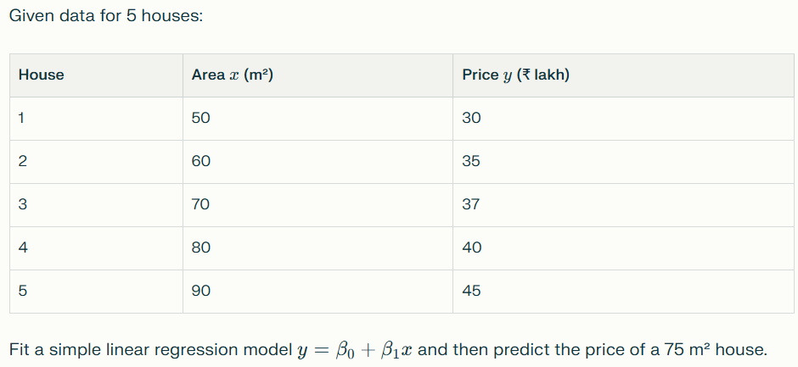
Linear Regression Problem

Slide 55
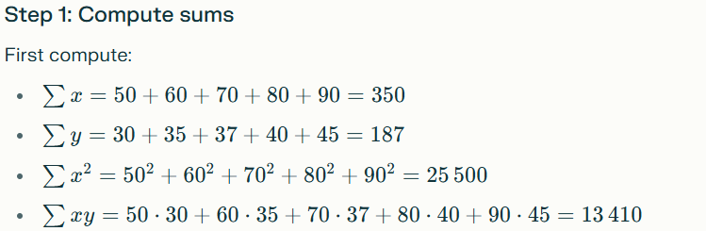
Linear Regression Problem

Slide 56
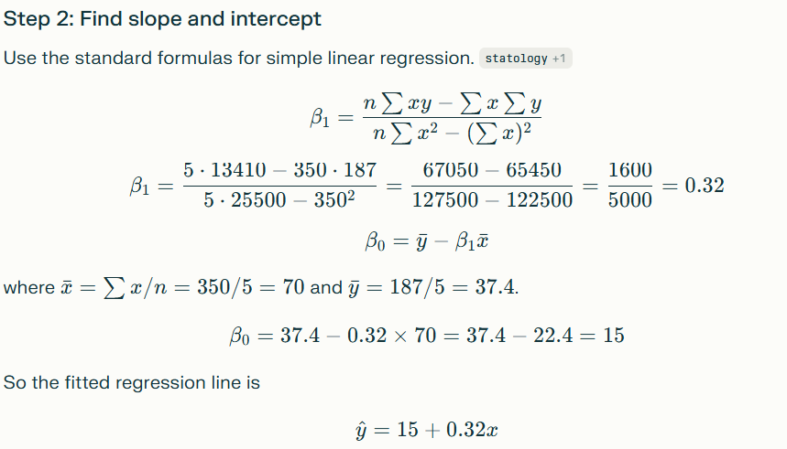
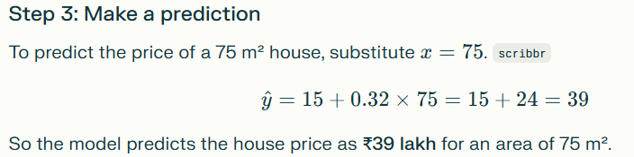

Slide 57
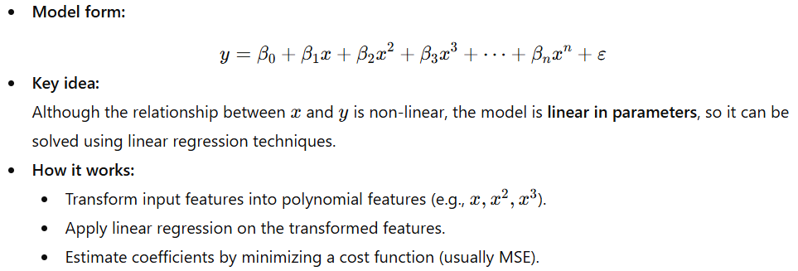
Polynomial Regression
Polynomial Regression is a type of regression model that captures a non-linear relationship between the independent variable(s) and the dependent variable by fitting a polynomial equation to the data.

Slide 58
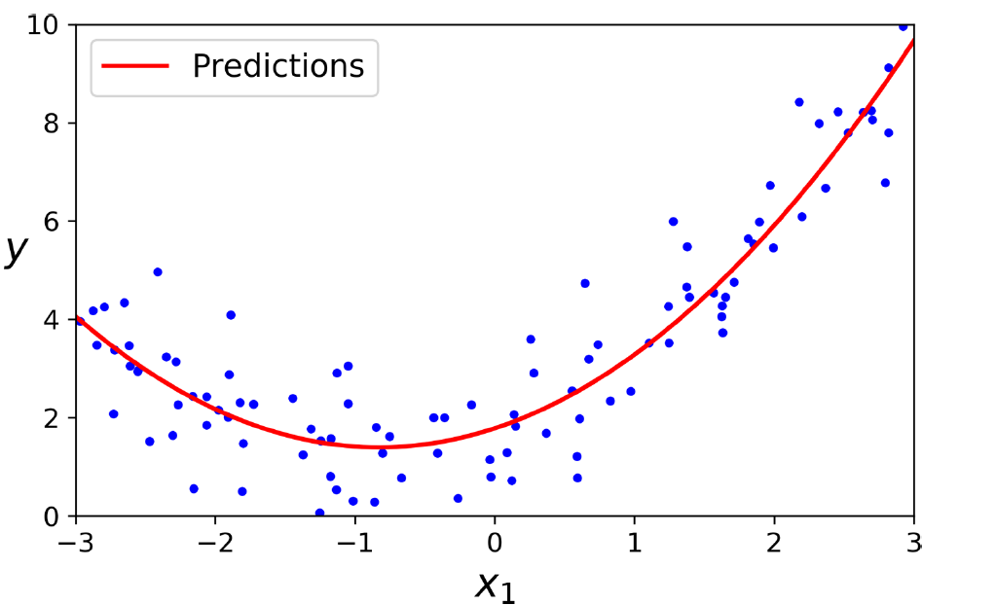
Polynomial Regression

Slide 59
Polynomial Regression
Advantages:
Models complex, curved trends in data.
More flexible than simple linear regression.
Easy to implement.
Disadvantages:
High-degree polynomials can cause overfitting.
Poor extrapolation outside the data range.
Sensitive to outliers.

